Slide 1
Show me, don’t tell me: Sprint 8 Demo
11 January 2022
Contract #: 36C10B21D0007
Order #: 36C10B21N00070001

Slide 2
Sprint 8 Approval (1 of 2)
CLIN 0001AB
Sprint Dates: 12/29/2021-1/11/2022
Sprint Goal: Conduct formalized testing* of current homepage design iterations using research plan and conversation guide approved by VA research lead. Hold collaboration kick-off, design intent, and, if able midpoint review* meetings. Evolve authenticated and unauthenticated homepage designs based on input from VA stakeholders through the collaboration cycle and / or design open office hours. Complete and socialize with VA-PO a draft of tiered feature requirements for homepage and secured messaging.
Priority | Epic: User Story | Acceptance Criteria
High | T&I: Iterate homepage designs (unauth) | Developed unauthenticated homepage designs (desktop / mobile) that reflect authenticated design scheme and level of fidelity Deliverable: Unauthenticated homepage designs (desktop / mobile)
High | Collaboration cycle: Kickoff | Held collaboration kick-off meeting 1/4/22 Recorded insights and recommendations in a shared document Deliverable: N/A
High | Collaboration cycle: Design intent | Held collaboration cycle design intent meeting 1/7/22 Recorded insights and recommendations in a shared document Iterated homepage designs based on feedback Deliverable: Evolved authenticated homepage designs (auth / unauth / desktop / mobile)
Low | Collaboration cycle: Midpoint review | Scheduled midpoint review in second week of January Recorded insights and recommendations in a shared document* Iterated homepage designs based on feedback* Deliverable: Evolved homepage designs (auth / unauth / desktop / mobile)*
High | T&I: Research plan | Socialized research plan, conversation guide, and designs to Lead VA researcher for review / edits / approval Submitted recruiting plan to Perigean Uploaded approved homepage design iteration to VA staging for research Deliverable: Approved research plan and conversation guide
* Dependency related to stakeholder availability / timing

Slide 3
Sprint 8 Approval (2 of 2)
CLIN 0001AB
Priority | Epic: User Story | Acceptance Criteria
High | T&I: Testing | Conducted user testing in accordance with research plan** Deliverable: N/A
High | T&I: Iterate homepage designs | Iterated homepage designs based on VA stakeholder feedback during design open office hour Deliverable: Evolved homepage designs (desktop / mobile / auth / unauth)
High | Homepage: Requirements Feature content | Draft, tiered feature content in shareable document Socialized with VA-PO and VA-DL for approval or down selection of feature requirements / priority Deliverable: N/A
Low | Secured messaging: Requirements Feature content | Draft, tiered feature requirements in shareable document Socialized with VA-PO and VA-DL for approval or down selection of feature requirements / priority Deliverable: N/A
** Dependency on user research testing timing

Slide 4
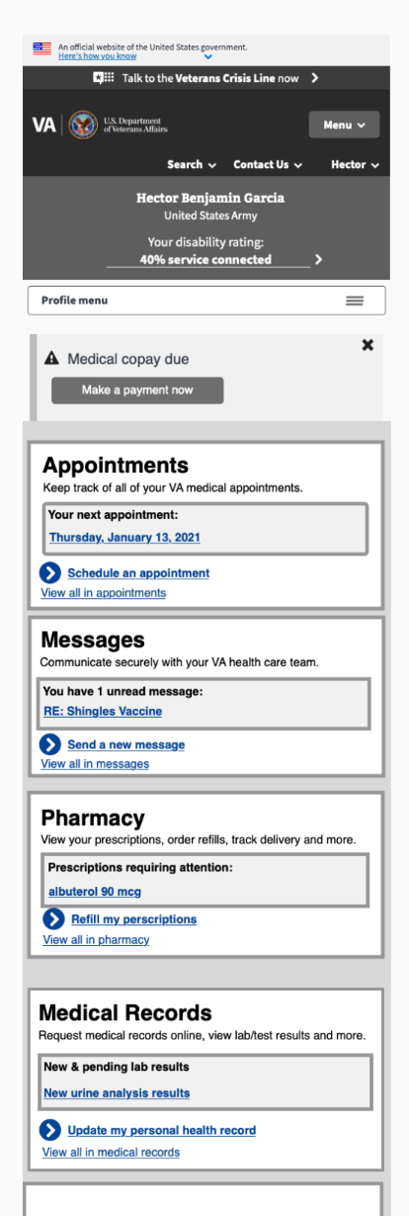
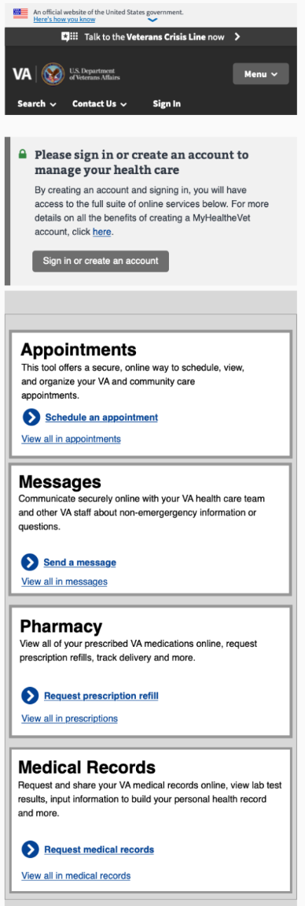
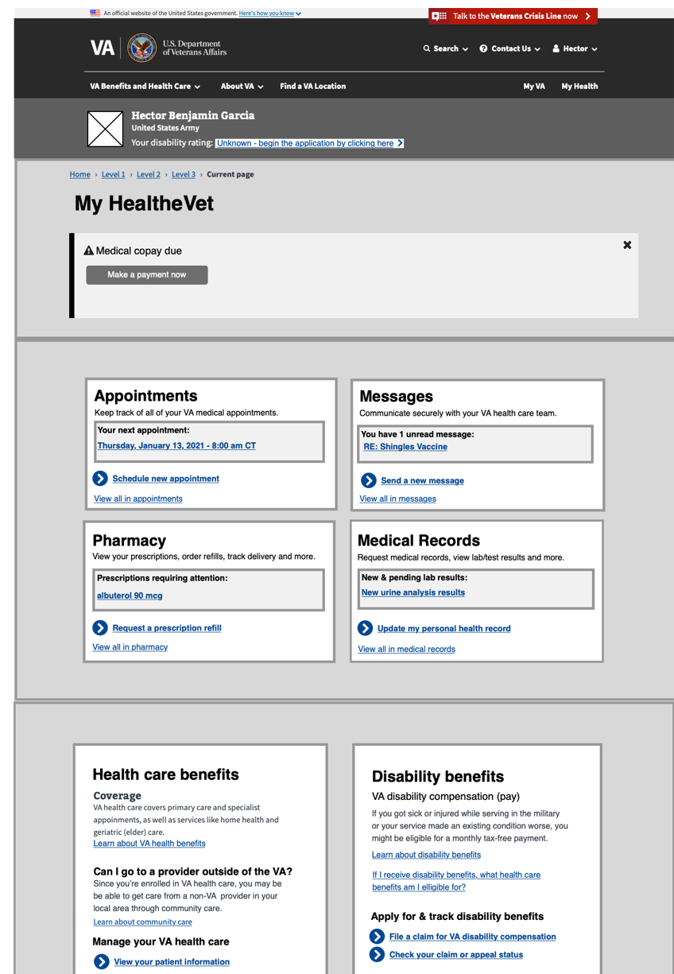
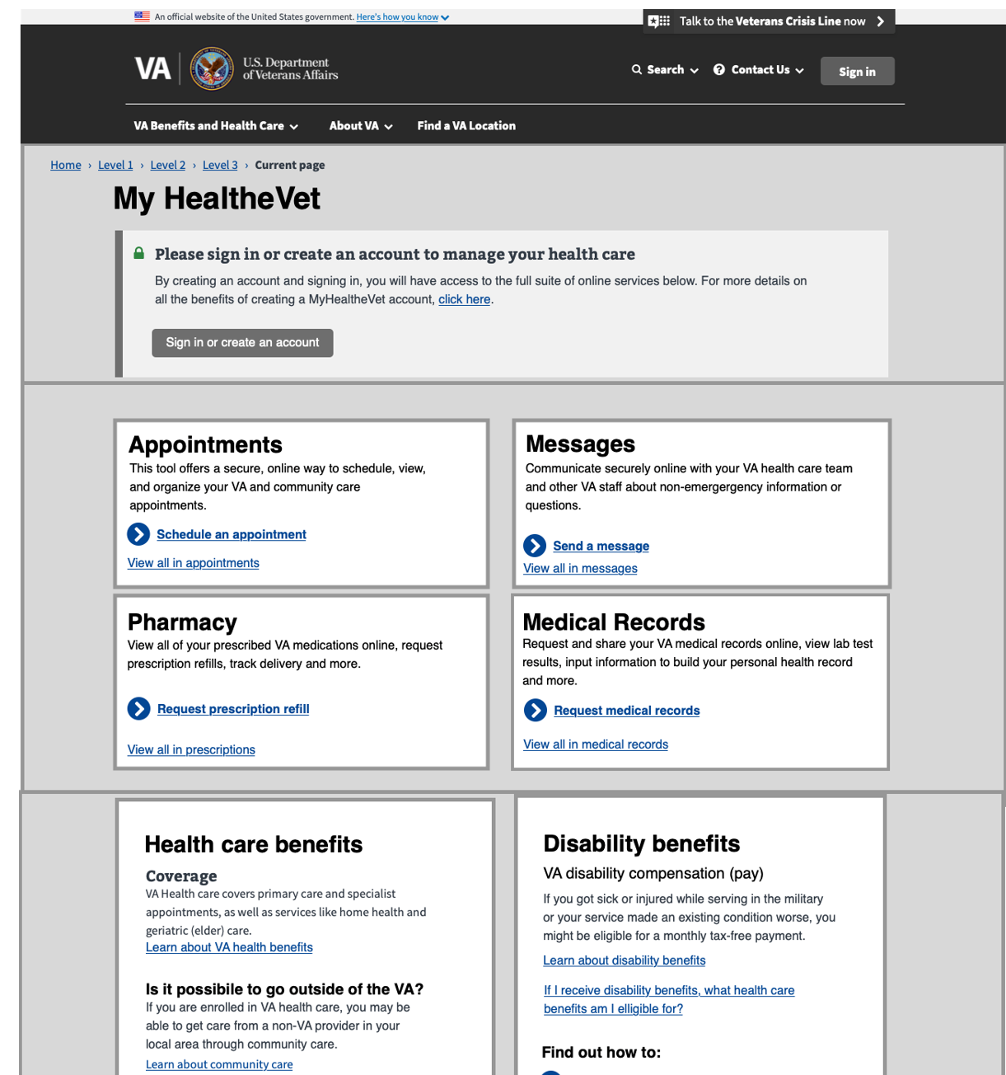
T&I: Iterated homepage designs (auth, unauth, desktop, mobile)
CLIN 0001AB
Deliverable: Iterated homepage designs
Notes:
paula 5-7

Slide 5
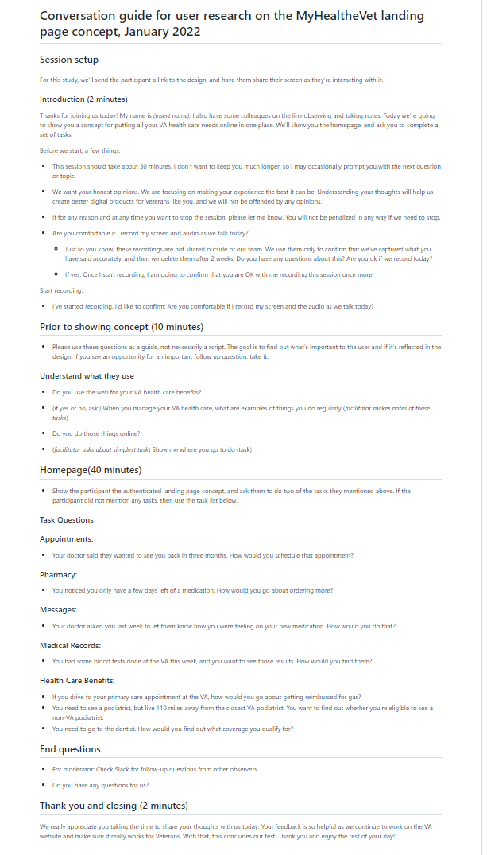
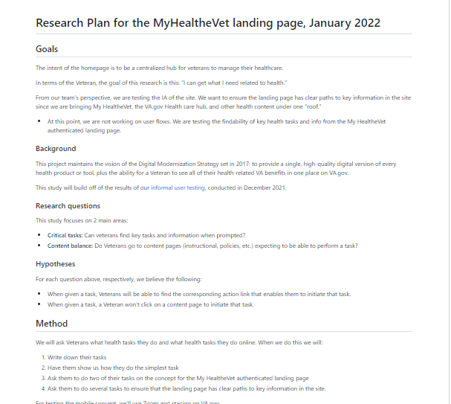
T&I: Formal research plan and conversation guide
CLIN 0001AB
Deliverable: Formal research plan
Deliverable: Conversation guide
Notes:
paula 5-7

Slide 6
Homepage: Proposed Features (draft)
CLIN 0001AB
Deliverable: Homepage Proposed Features (draft)
Notes:
paula 5-7

Slide 7
Secure messaging: Proposed Features (draft)
CLIN 0001AB
Deliverable: Secure messaging: Proposed Features
Notes:
paula 5-7

Slide 8
End of Sprint 8 Update
CLIN 0001AB
The team’s accomplishments this sprint include:
Homepage requirements, draft
Prepared template for presenting tiered feature concepts in Mural 1/3
Entered data for tiered feature content 1/7
Socialized tiered feature content with VA-PO 1/10
Secure messaging requirements, draft
Prepared template for presenting tiered feature concepts in Mural 1/3
Tiered secured messaging featured content into Mural 1/4
Socialized tiered feature content with VA-PO 1/5
Formal Research
Received new instructions from VA in how to route formal research for approval 1/4
Changed user testing demographics based on insights from collaboration cycle meeting 1/4
Received feedback from VA-DL 1/5
Completed change request from VA-DL 1/7
Submitted research plan and conversation guide for approval to Straussberg and Hoffman 1/8
Research plan approved by Straussberg 1/10
Unauthenticated homepage wireframe, low fidelity (web / mobile)
Transferred design features from auth to unauth wireframes 12/29-12/30
Socialized with VA-PO and VA-DL 1/3
Iterated designs based on feedback 1/5,1/6, 1/7, 1/10
Iterated designs (desktop / mobile / auth / unauth)
Held closed design session w/ design team 12/29, 12,30
Located / connected w/Chatbot and Analytics POC 12/29, 12/30
Researched MHS Genesis and Disability tracker 12/29, 12/30
Final design open office hours 1/7
Collaboration cycle: Kickoff (1/4)
Prepared homepage designs for presentation in Mural 1/3
Presented at collaboration cycle kickoff event 1/4
Discussed insights from meeting with design team 1/4
Stakeholder engagement
Design open office hours 12/30, 1/4, 1/6
Design Q&A session 1/5
Collaboration cycle 1/4
Team of Teams 1/4, 1/11
Design and research content sync 1/10
Analytics and insights meeting 1/5
VA-PO MO-PM sync 1/6
Preparatory research for future sprints
Researched MHS Genesis patient portal layout / content 12/30
Researched resource content across VFS sites 1/3, 1/4
Researched secure messaging storage capabilities 1/5
Research on Disability benefit usage in Google analytics 1/6

Slide 9
Sprint 8 Acceptance
CLIN 0001AB
Sprint Dates: 12/29/2021-1/11/2022
Sprint Goal: Conduct formalized testing of current homepage design iterations using research plan and conversation guide approved by VA research lead. Hold collaboration kick-off, design intent, and, if able midpoint review meetings. Evolve authenticated and unauthenticated homepage designs based on input from VA stakeholders through the collaboration cycle and / or design open office hours. Complete and socialize with VA-PO a draft of tiered feature requirements for homepage and secured messaging.
Focused Epics (Approval)
T&I: Iterate homepage designs (unauth)
Collaboration cycle: Kickoff
Collaboration cycle: Design intent
Collaboration cycle: Midpoint review
Homepage: Requirements (draft)
Secure messaging: Requirements (draft)
T&I: Research plan
T&I: Testing
T&I: Iterate homepage designs (auth / unauth / desktop / mobile)
Focused Epics (Acceptance)
√ T&I: Iterate homepage designs (unauth)
√ Collaboration cycle: Kickoff
Collaboration cycle: Design intent Deferred by VA-PO
Collaboration cycle: Midpoint review Deferred by VA-PO
√ Homepage: Requirements (draft)
√ Secure Messaging: Requirements (draft)
√ T&I: Research plan
T&I: Testing Deferred by VA-PO
√ T&I: Iterate homepage designs (auth / unauth / desktop / mobile)
Deliverables Name / Description | Acceptance Criteria
Homepage wireframes (auth, unauth, web, mobile) | √ Developed unauthenticated homepage designs (desktop / mobile) that reflect authenticated design scheme and level of fidelity Iterated homepage designs based on VA stakeholder feedback during design open office hour
Approved research plan and conversation guide | √ Socialized research plan, conversation guide, and designs to VA researcher for review / edits / approval
Tiered feature content: Homepage (draft) | √ Draft, tiered feature content in shareable document √ Socialized with VA-PO and VA-DL for approval or down selection of feature requirements / priority
Tiered feature content: Secured messaging (draft) | √ Draft, tiered feature content in shareable document √ Socialized with VA-PO and VA-DL for approval or down selection of feature requirements / priority

